Slide 1
MPCA LAB MINI PROJECT
PROJECT TITLE: HOME AUTOMATION
SECTION: H2
STUDENTS NAME: SUMUKH RAJU BHAT & SUHAS RK
SRN’s: PES1UG19CS519 & PES1UG19CS514

Slide 2
PROBLEM STATEMENT
Home automation or domotics is building automation for a home, called a smart home or smart house.
A home automation system will monitor and/or control home attributes such as lighting, climate, entertainment systems, and appliances. I

Slide 3
INTRODUCTION
Motion Based Switches:
Control surrounding’s appliances with contactless motion sensors which serve as alternative for traditional switches.
Temperature Based Ceiling Fans:
Fans that turn on or off based on temperature of the surroundings.
Distance based automatic doors:
Automatic contactless doors that close/open when someone wishes to pass through it.

Slide 4
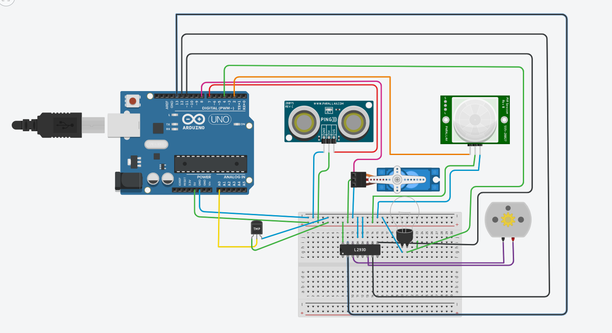
BLOCK DIAGRAM

Slide 5
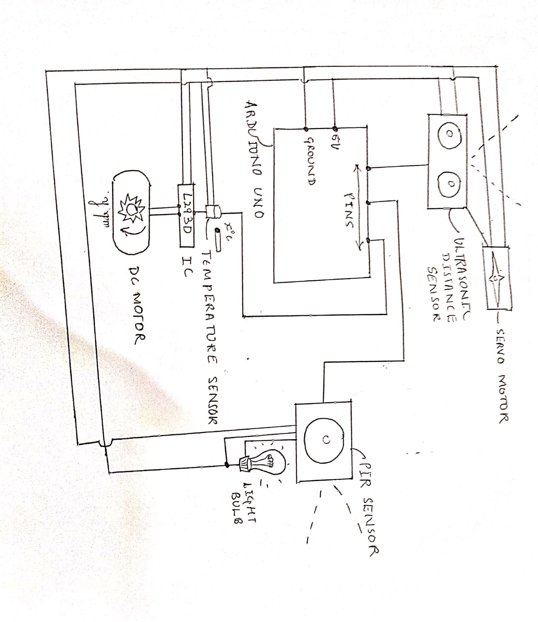
BLOCK DIAGRAM

Slide 6
REQUIRED COMPONENTS
Quantity | Component
1 | Arduino UNO
1 | Ultrasonic distance sensor
1 | Positional Micro Servo
1 | PIR(Infrared) Sensor
1 | Temperature Sensor
1 | IC chip
1 | DC motor
1 | Light bulb

Slide 7
PROJECT DESCRIPTION/DEMONSTRATION
Let’s watch a live demo...

Slide 8
APPLICATIONS/ADVANTAGES
User friendly techniques to control appliances.
Higher security.
Contactless technologies avoid spread of viruses like COVID-19.
Save electricity.

Slide 9
REFERENCES
Learning basics of Tinkercad: https://all3dp.com/2/tinkercad-tutorial-easy-beginners/
Tinkercad basics: https://www.youtube.com/watch?v=38ur1kyFYxc
Home Automation: https://www.youtube.com/watch?v=0i7gKcAliiE
Using PIR sensors: https://www.youtube.com/watch?v=PpA4ETebzVQ
Using Temperature sensors: https://www.youtube.com/watch?v=sFmuz4mU5w8
Using Ultrasonic sensors: https://www.youtube.com/watch?v=WSuIad9Ehd4

Slide 10
THANK YOU

